Slide 1
CS-541 Deep Learning
Final Project Presentation
3D Object Detection on KITTI Dataset
Presented by Group 29
Abhishek Jain, Nagarjun Vinukonda, Rishabh Chadha, Vrushabh Desai

Slide 2
INTRODUCTION
The ideas from 2D object detection are not directly transferable to 3D object Detection.
This is because 3D object detection deals with input data in the form of a point cloud.
For 3D object detection, we need to draw a 3D bounding box in 3D space
We have used the KITTI dataset which includes 2D images, Point cloud data obtained using a Velodyne Laser Scanner.

Slide 3
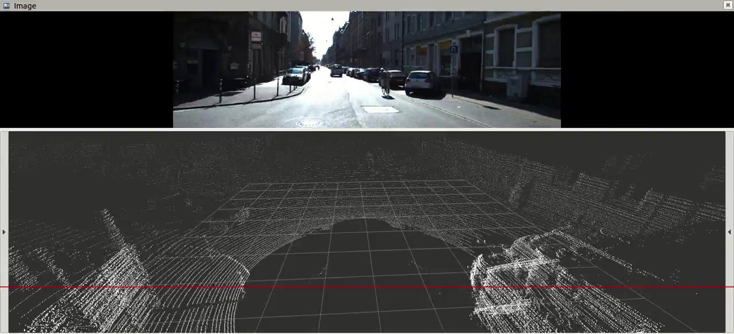

Slide 4
Related Work
There have been different approaches to tackle the problem of applying Deep Learning on Point Clouds.
Few of them involve representing point clouds as a collection of 2D images over which 2D convolution is applied. Spatial information is lost in these methods and architectures have been developed in order to directly work with raw point clouds.
Other approaches have attempted to discretize the point cloud into a volumetric 3D grid and then apply 3D convolutions over that volume to classify if it contains an object of interest.

Slide 5
Background
We have performed modifications on the Frustum Point-Net architecture to carry out 3D object detection on the KITTI dataset.
Frustum PointNets take advantage of existing 2D detection algorithms to help in localizing an object of interest in 3D point clouds.
This reduces the volume which needs to be searched in the point cloud for an object of interest.

Slide 6
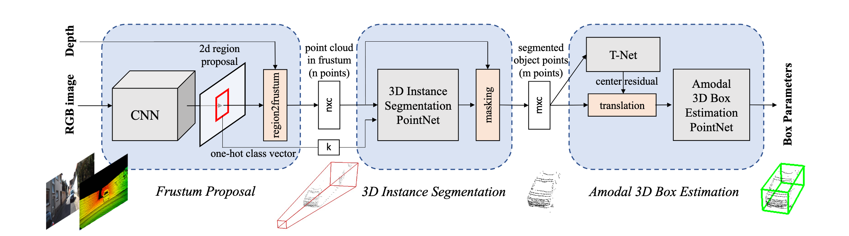
Background
Fig. Frustum Point-Net Architecture

Slide 7
Contributions
The authors have used a tuned Fast R-CNN for 2D object detection from images.
We replaced the Fast R-CNN with SqueezeDet for obtaining the 2D regions of interest.
SqueezeDet is an architecture that was designed particlarly for carrying out 2D object detection which can be deployed on embedded systems in Autonomous vehicles.
Also, the influence of the loss function on the overall performance of the model was explored.

Slide 8
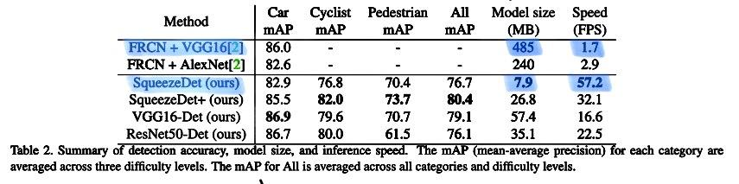
Contributions
Our motivation to use SqueezeDet was due to its significant low memory model size and high speed.

Slide 9
Approach
For the Frustum PointNet architecture, 2D region proposals are extruded in the form of a frustum in the point cloud which helps to localize the objects of interest.
We replaced the original Fast-RCNN 2D proposals by proposals from SqueezeDet.
This would lead to different 3D frustum point cloud regions of interest and hence would change the overall results of the model as well

Slide 10
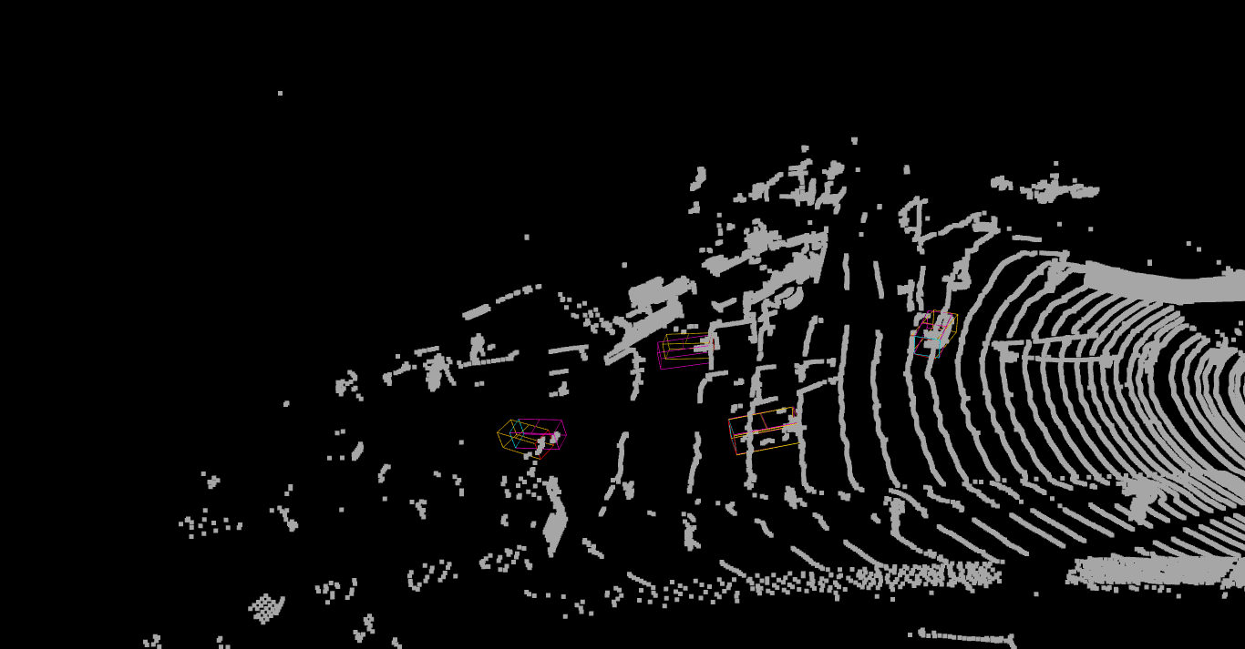
MSE Loss Example 1

Slide 11
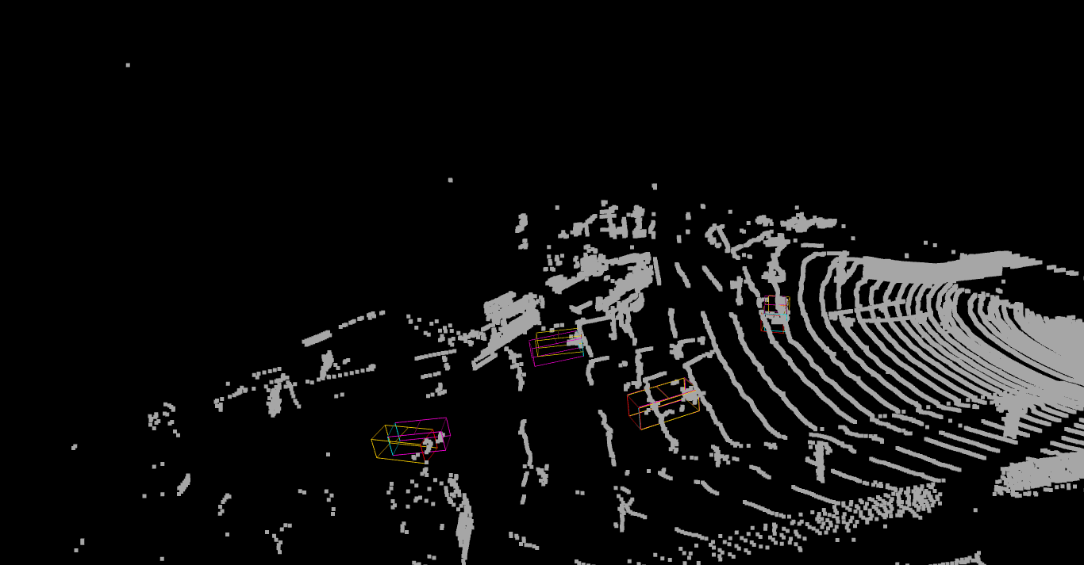
Smooth L1 loss Example 1

Slide 12
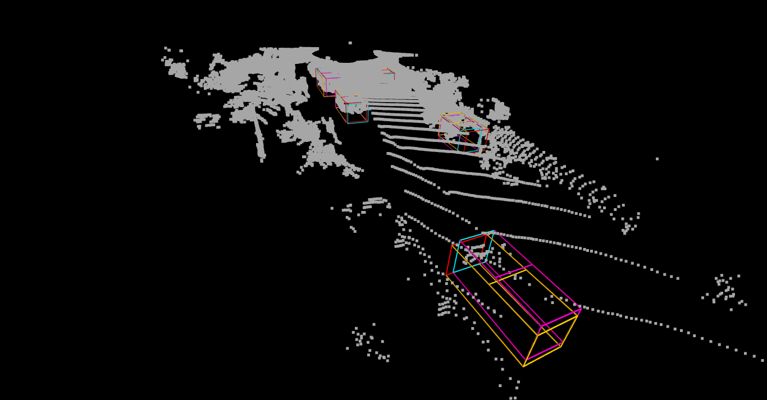
MSE Loss Example 2

Slide 13
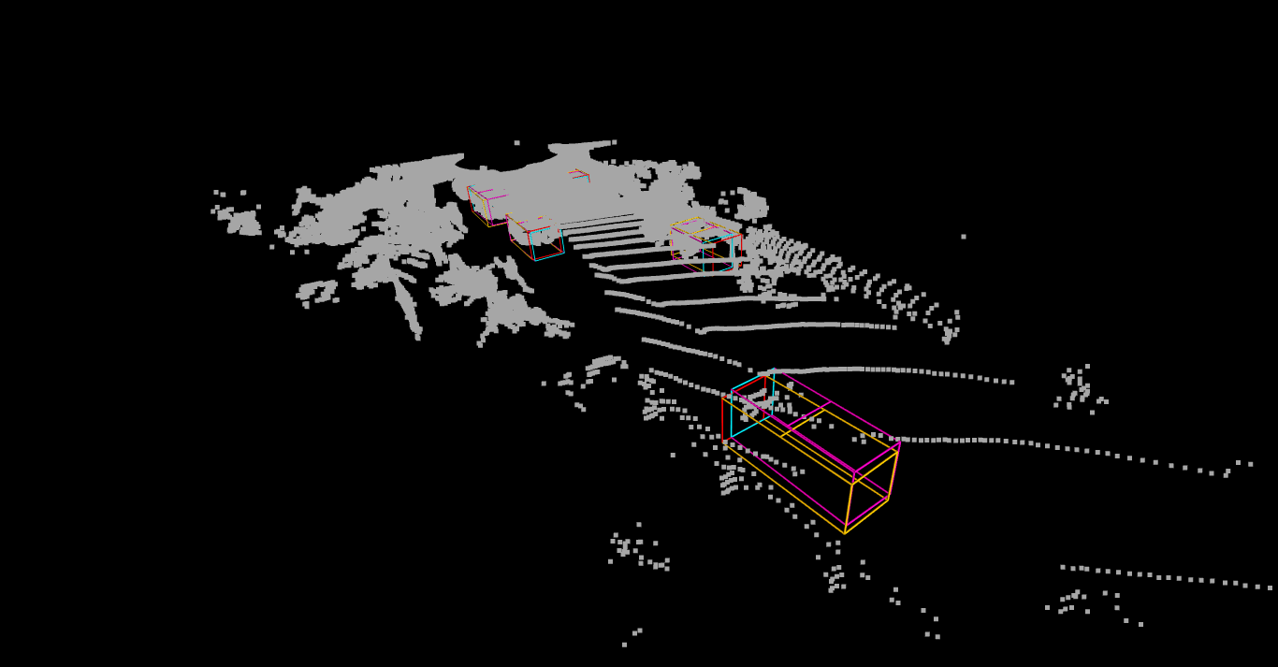
Smooth L1 Loss Example 2

Slide 14
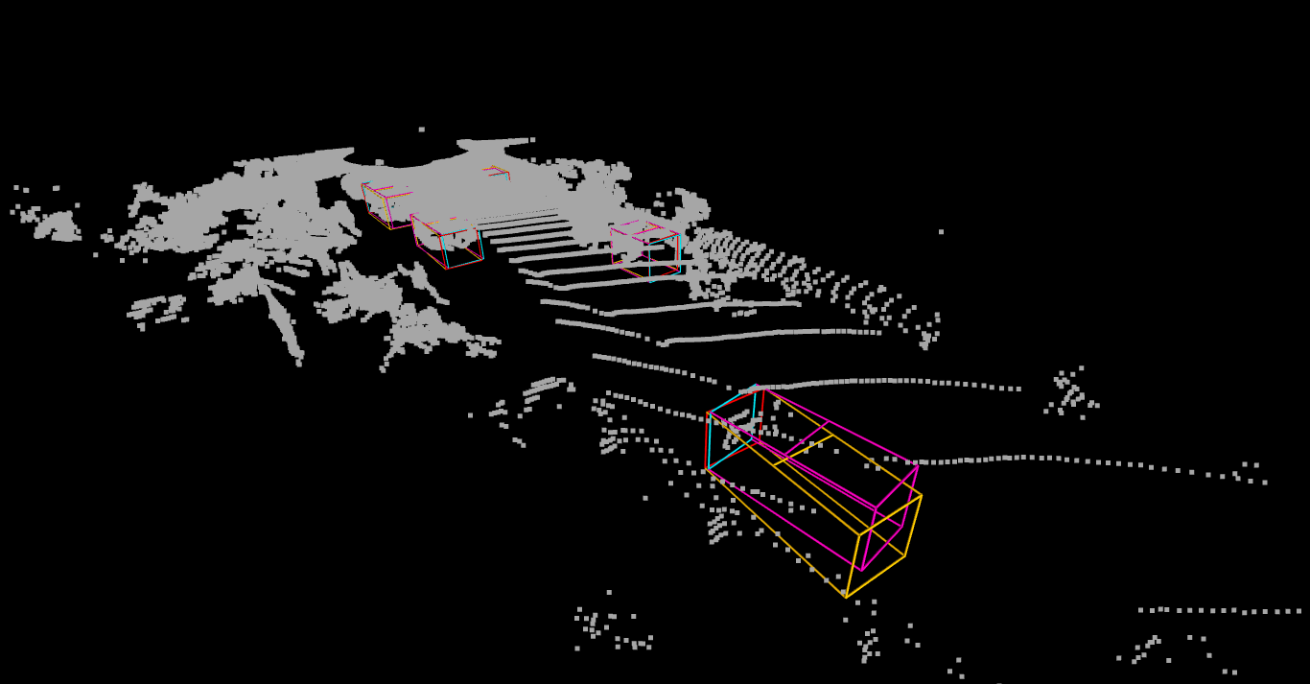
Training at 450 epochs (Regular Loss)

Slide 15
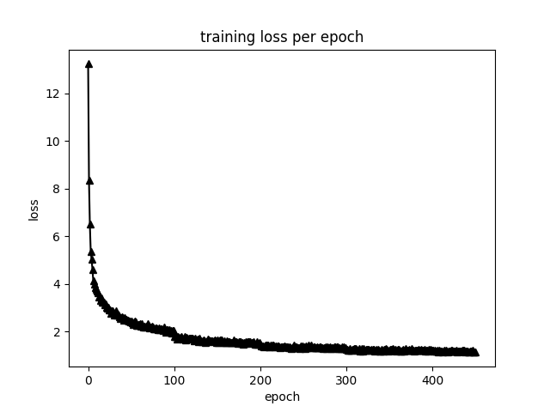
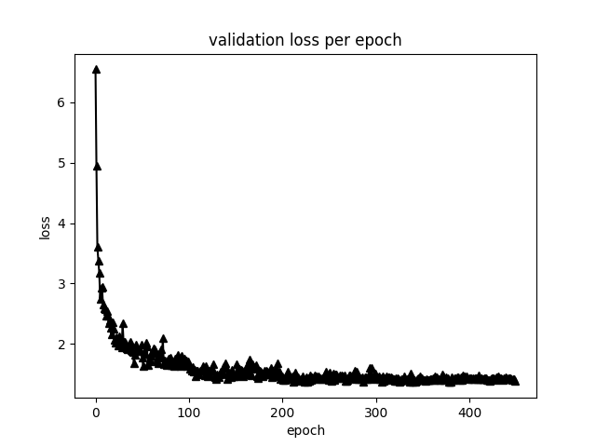
Smooth L1 Loss
Optimizer: Adam: Learning Rate: 10⁻³
Batch Size = 32

Slide 16
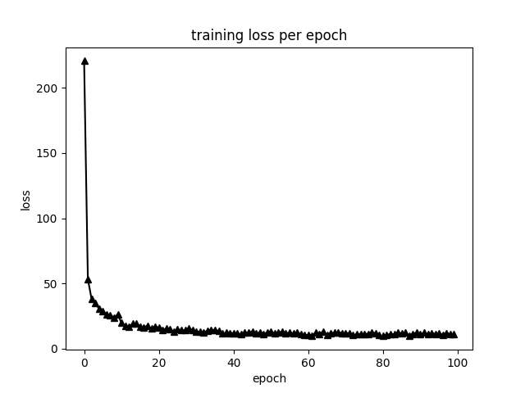
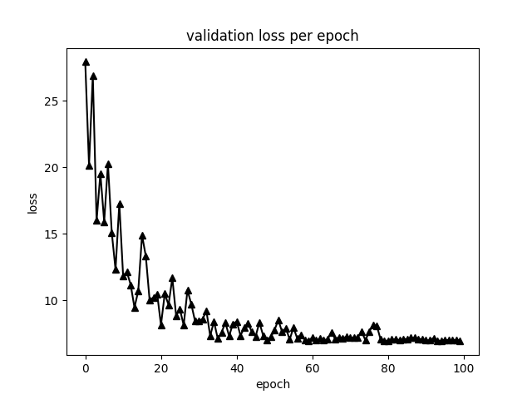
MSE Loss
Optimizer: Adam: Learning Rate : 10⁻³
Batch Size = 32

Slide 17
Results 2D Detection
Car detection 2D | Easy | Moderate | Hard
Frustum PointNet Original | 0.87 | 0.819 | 0.73
Modified Frustum PointeNet | 0.88 | 0.814 | 0.83
2D Detection AP: Average precision

Slide 18
Results 3D Detection
Car detection 3d | Easy | Moderate | Hard
Frustum Point Original | 0.82 | 0.68 | 0.61
Modified Frustum PointNet | 0.58 | 0.55 | 0.52
3D Detection AP: Average precision

Slide 19
Conclusion
Our aim was to perform 3D object detection on the KITTI Dataset by studying and modifying the Frustum Point-Net architecture.
We modified the technique of generating 2D region proposals by incorporating SqueezeDet inplace of Fast-RCNN and analyzed the corresponding results.
We also studied the impact of using an alternative loss function: MSE loss in place of L1 loss.
The duration for training the model proved to be a major roadblock because it took almost 2 days to train.

Slide 20
Thank You Questions?

